Slide 1

SoftCopy
Image-based book recommendation

Slide 2
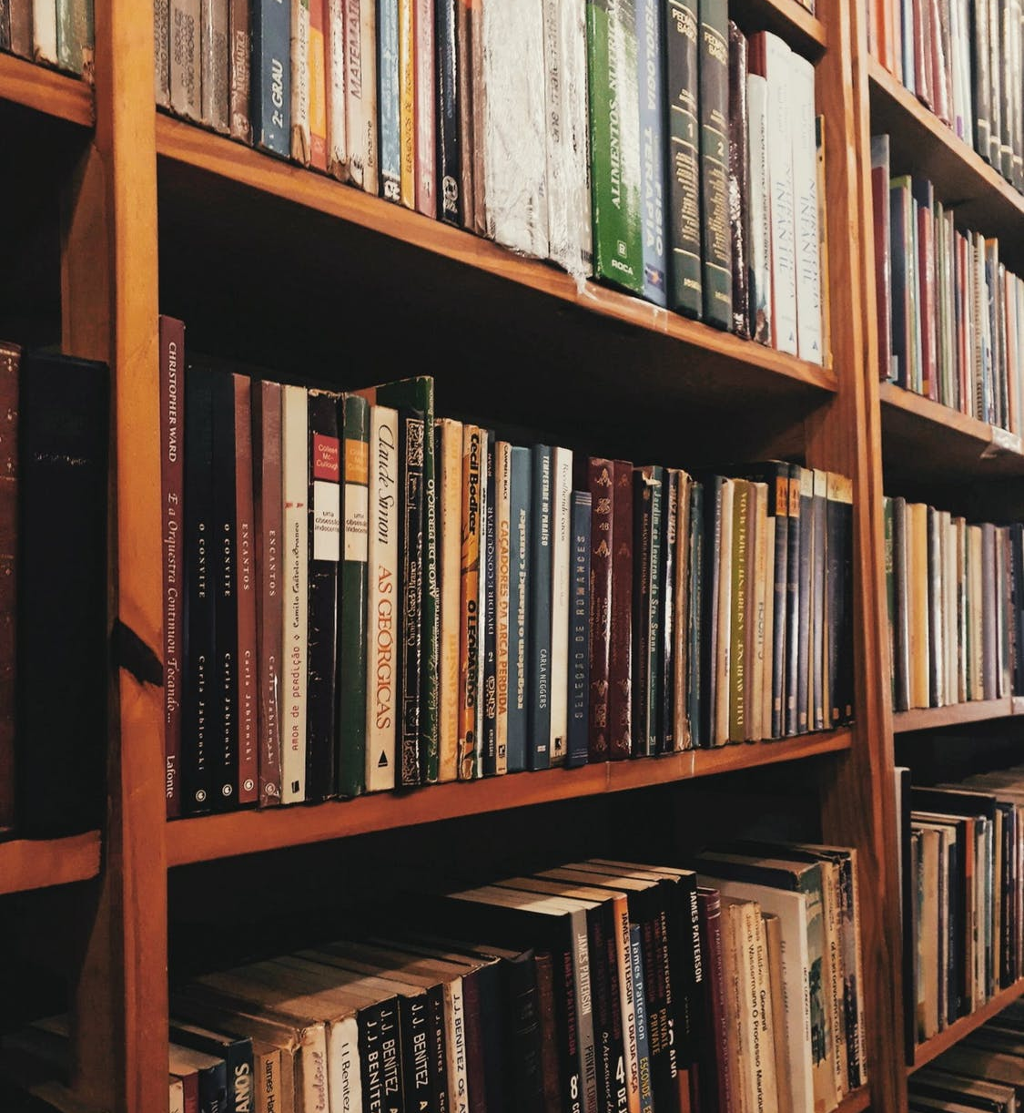
What is SoftCopy?
Get book recommendations from just an image of your bookshelf
Effortlessly leverage your offline book collection to generate insights
Simply upload a photo and the app does the rest!
Notes:
Process: user uploads a photo of their bookshelf and the app processes that image and produces book recommendations based off of other titles detected in the users image.
One of the reasons I chose this project is because I've become really interested in leveraging 'offline' data.
A person’s individual book collection is a prime example of a large quantity of information about someone that is difficult to digitally catalogue.
So I wanted to build something that makes that process quick and easy, so i could use that information to generate insights.

Slide 3
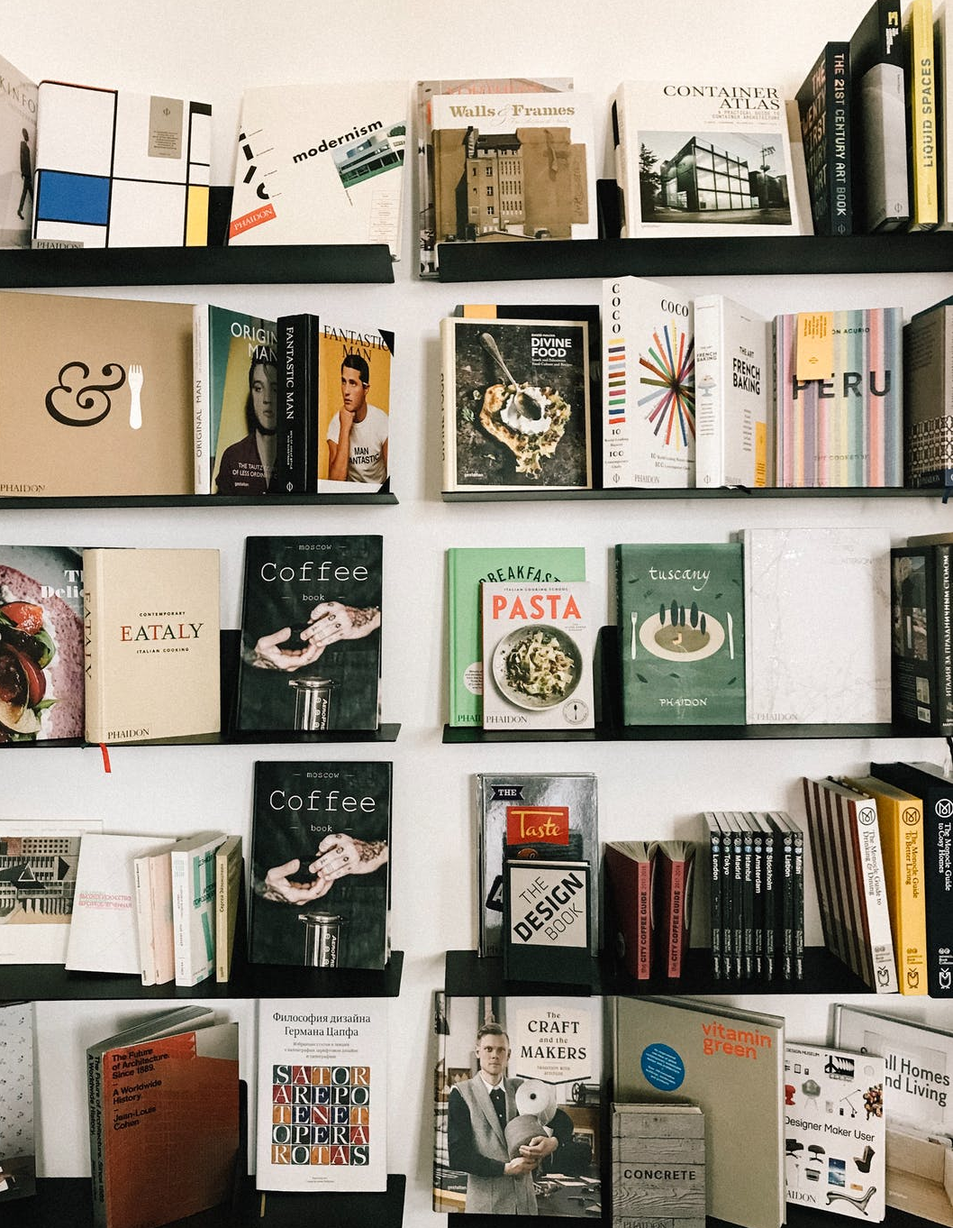
Methodology
Upload Image
Optical Character Recognition
Notes:
after a user uploads their image...
... first step the app takes is OCR

Slide 4
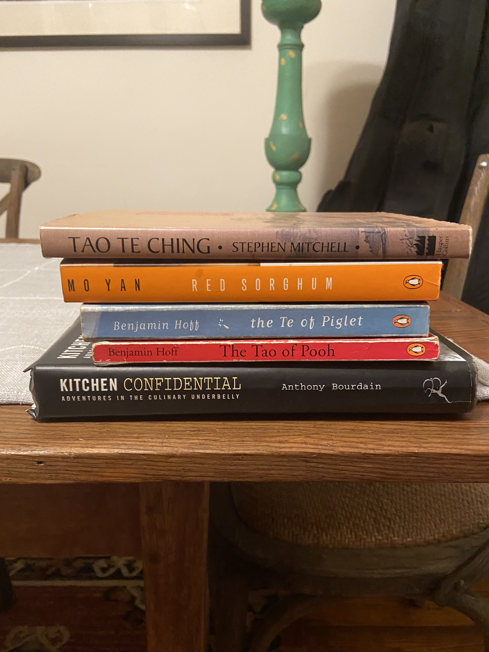
Optical Character Recognition
Preprocessing
Image scaling
Color swapping
Mean image subtraction
Notes:
App leverages OpenCV and Pytesseract to process the user's uploaded image
After some initial preprocessing, OpenCV draws bounding boxes that wrap around each cluster of text in the image.

Slide 5
Optical Character Recognition
Preprocessing
Text detection
OpenCV EAST text detection model
Bounding box detection
Non-maxima suppression
Notes:
boxing off text

Slide 6
Optical Character Recognition
Preprocessing
Text detection
OpenCV EAST text detection model
Bounding box detection
Non-maxima suppression

Slide 7
Optical Character Recognition
Preprocessing
Text detection
OpenCV EAST text detection model
Bounding box detection
Non-maxima suppression

Slide 8
Optical Character Recognition
Preprocessing
Text detection
Text recognition
Pytessaract pretrained LSTM neural network model
Returns text from each bounding box
ANTHONY BOURDAIN
Notes:
Then Pytesseract's pretrained neural network attempts to interpret what the text in each box says.
Once the text in every bounding box has been ”read” by Pytesseract, the app can move on to the next step…

Slide 9
Methodology
Upload Image
Optical Character Recognition
Text Matching
Notes:
…which is matching the text pulled from OCR to actual book titles in the database.

Slide 10
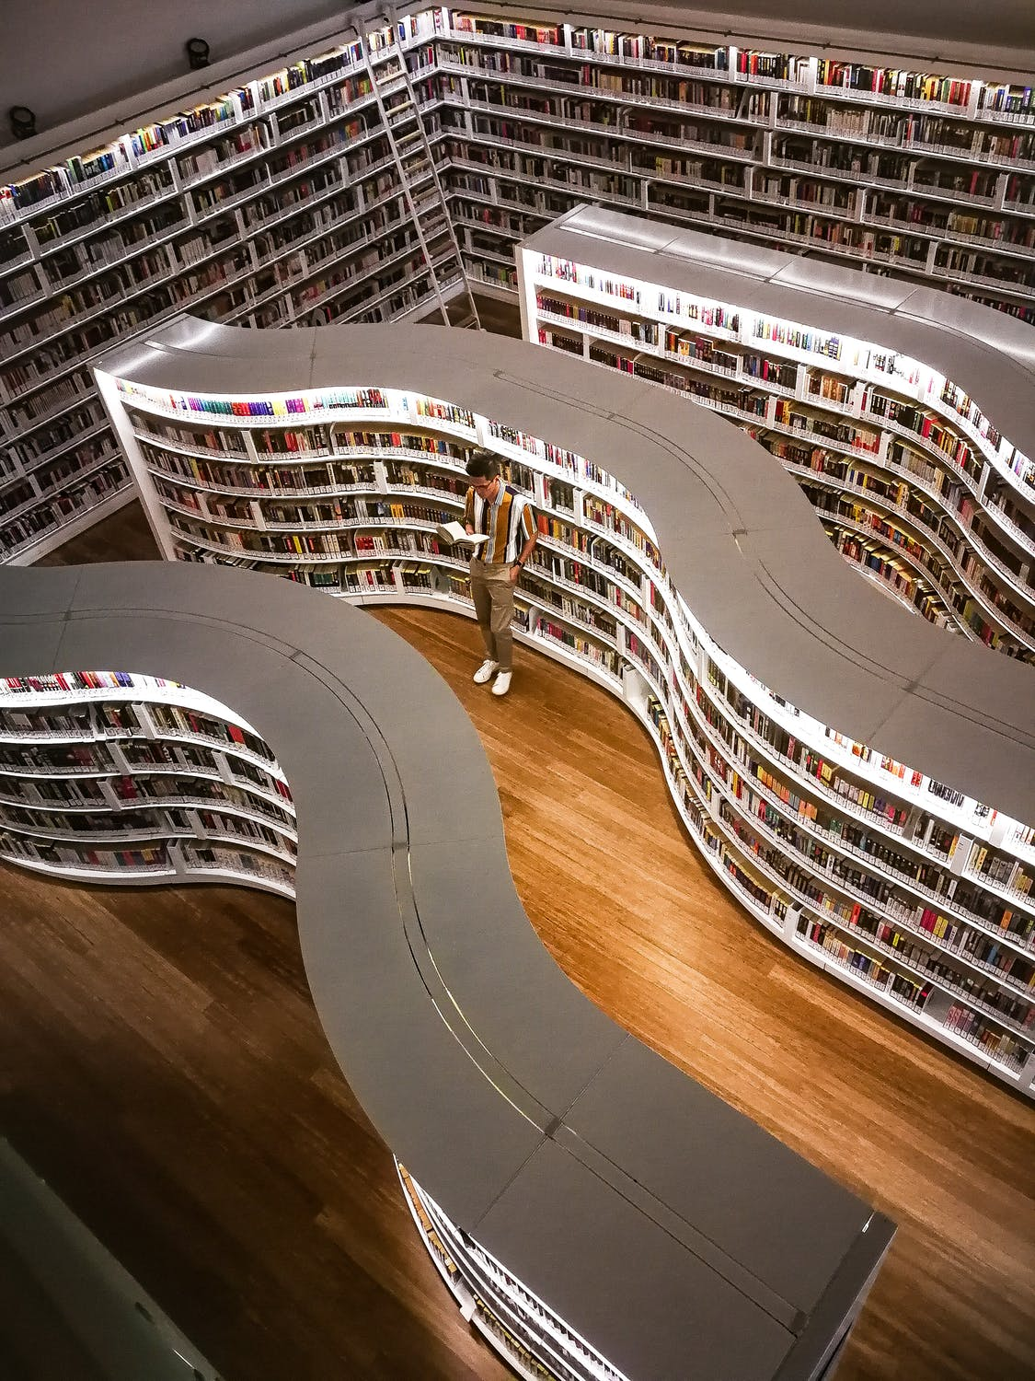
Text Matching
266,664 books pulled from the Book Crossing dataset
Five-step fuzzy matching process the title and author
User sets confidence threshold to determine cutoff point for matches
Notes:
To do this I pulled in over a quarter million book titles from the Book Crossing dataset…
…essentially an enormous set of user-generated, numerical reviews of books.
Each cluster of text read in by OCR gets paired with a title and author from the database using a five-step fuzzy matching process.

Slide 11
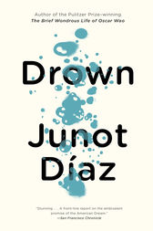
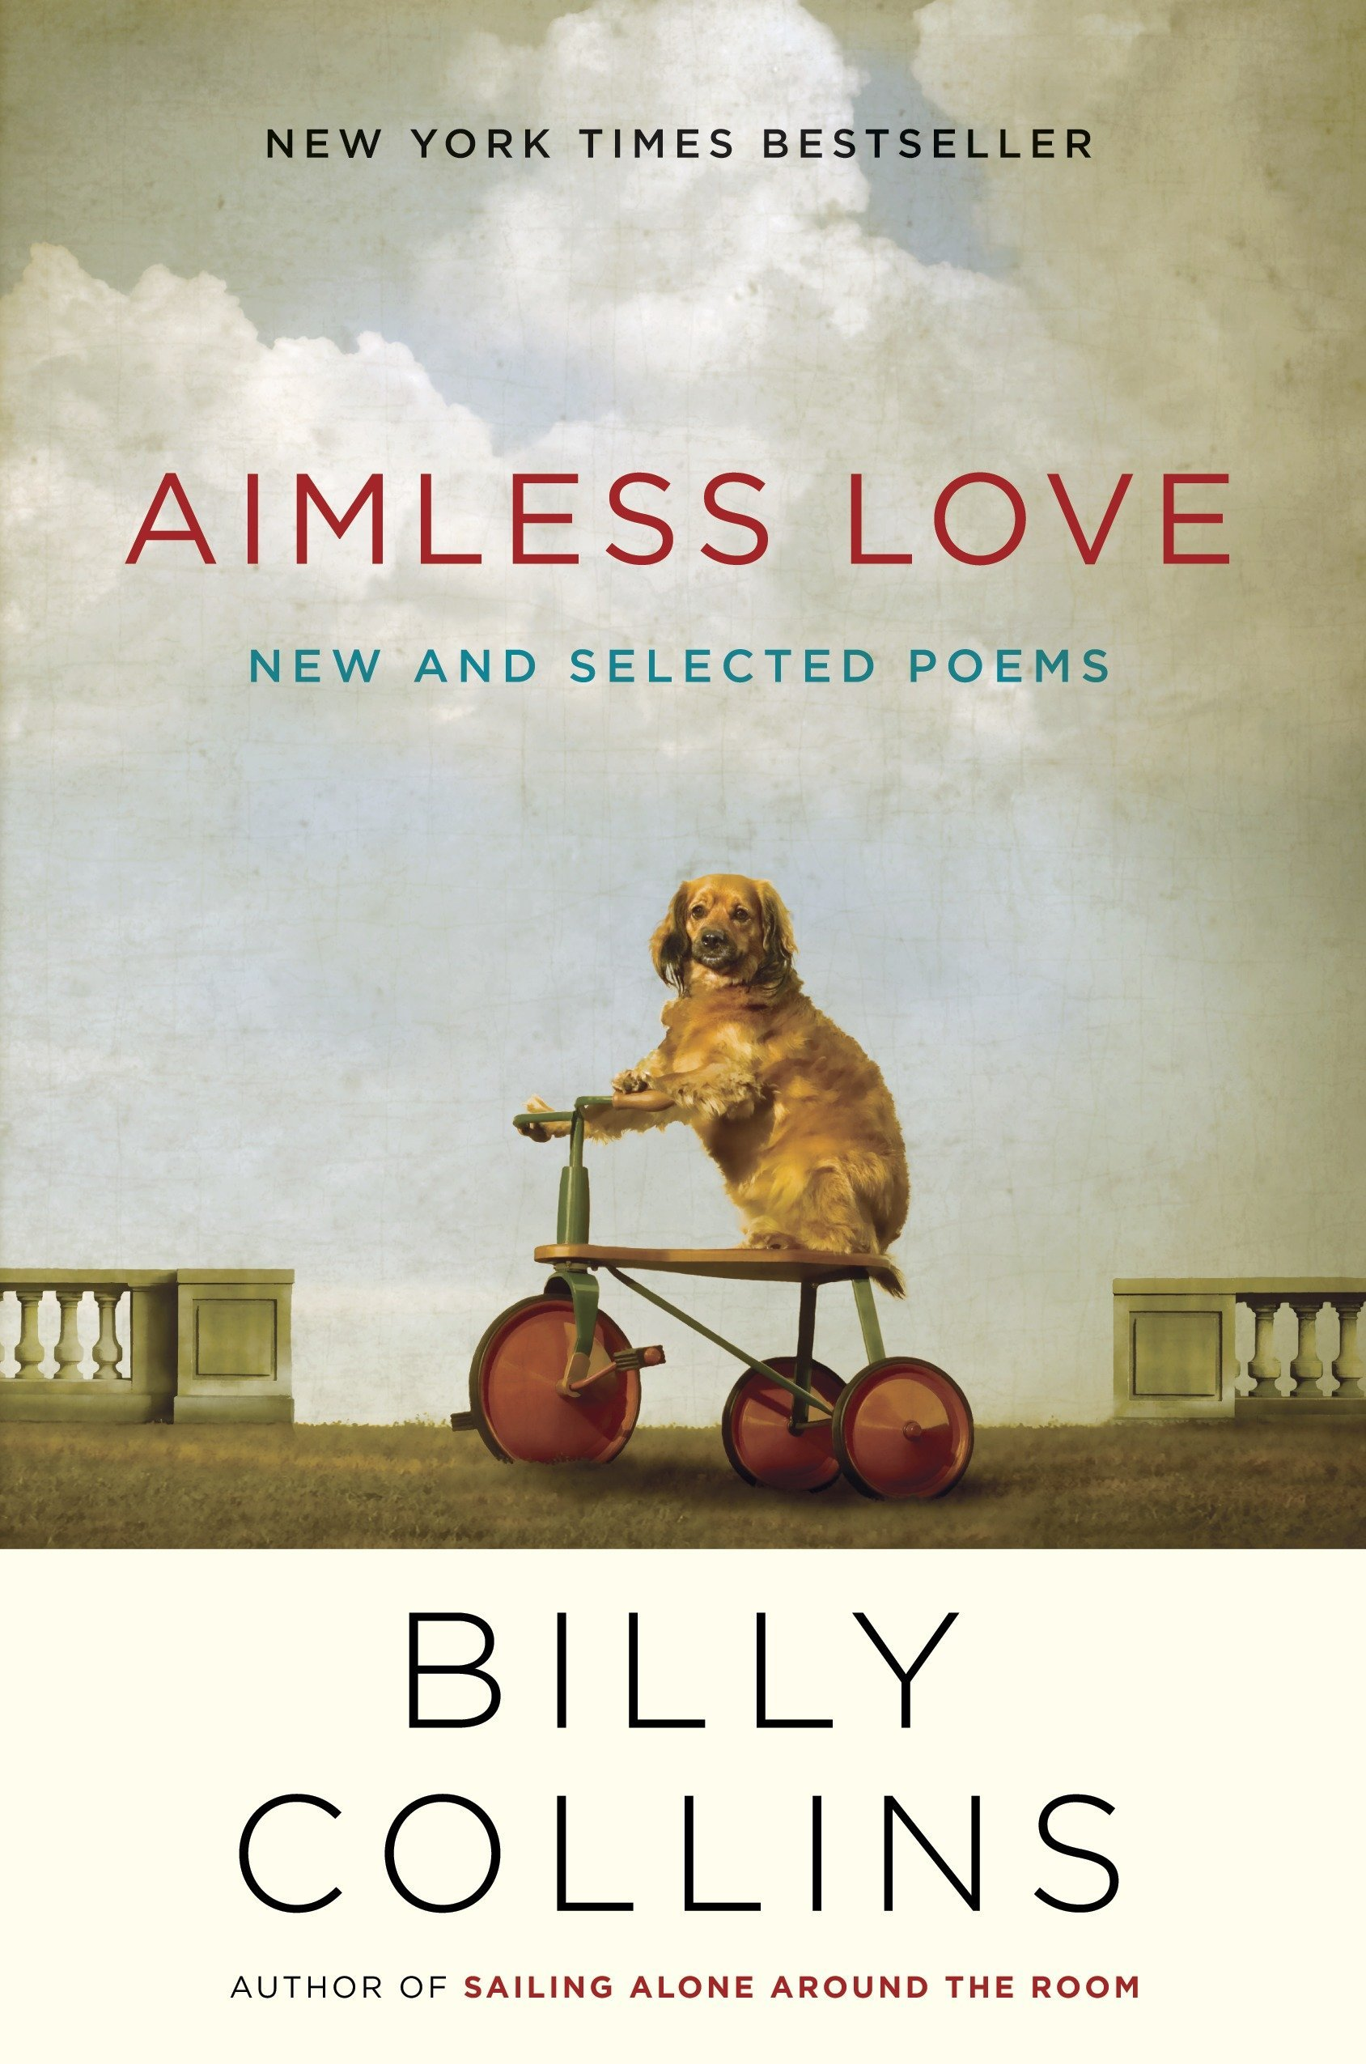
Text Matching
Confidence threshold: 75%
OCR
MATCH
Drown by Junot Diaz
with 77% confidence
"my ea t diaz junto d”
"sil lack a sian sos oo tian m e a r ii lom aimles ba al”
Smile Like a Plastic Daisy by Sonia Levitin
with 56% confidence
OCR
NO MATCH
Notes:
Let’s take a look at an example of two books that have gone through this process.
……

Slide 12
Methodology
Upload Image
Optical Character Recognition
Text Matching
Recommendation
Notes:
After the image has gone through OCR and text matching, it’s finally time to get to the fun part—recommendation.

Slide 13
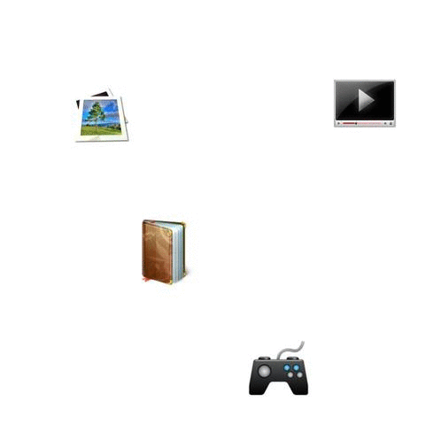
Recommendation
Collaborative filtering suggests books based on user ratings
Singular value decomposition (SVD) breaks ratings into 800 abstract categories
Cosine similarity determines closest match!
Notes:
While *content-based* recommender systems are very practical and reliable, I thought it would be more interesting to employ a *collaborative filtering* approach…
...where only user-review data is used make recommendations.
I did this by using SVD to break each book’s review scores into 800 distinct categories…
…and cosine similarity to compare what books have most in common across these categories
Because collaborative filtering is strictly based on user behavior, it should be able to exploit some hidden correlations in the data...
...as opposed to a content-based recommendation, which would see that you like a genre and just give you more of that genre.
Now that we’ve taken a look at how the app works under the hood, let's check out how it works in practice.

Slide 14
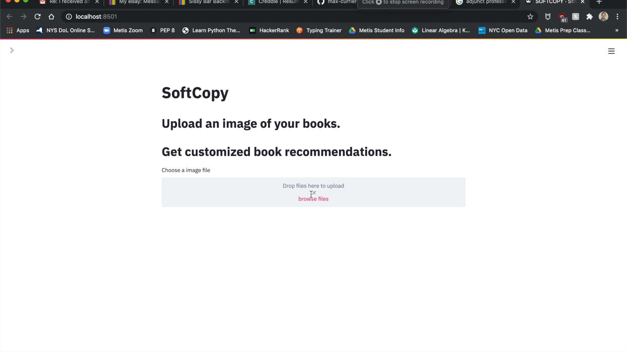
App Demo: Main Functionality
Notes:
*** Sidebar parameters
In this example, we’ve got a handful or recommendation baseds off a couple books that were in the uploaded image
Although some of these titles aren’t a strict genre match, that is exactly what we anticipated from collaborative filtering, so if we look more closely at the recommended titles we can think about why were getting these suggestions.
The first few are based off **1**, and you'll notice that many of these suggestions
1. Themes of self-reflection and romance set in Europe (not all novels)
2. Center around characters who take an alternative life path, seeking freedom in some way, popular with teenage readers
If you're less familiar with the books that have been suggested, the app also allows you to judge its' recommendations by their covers

Slide 15
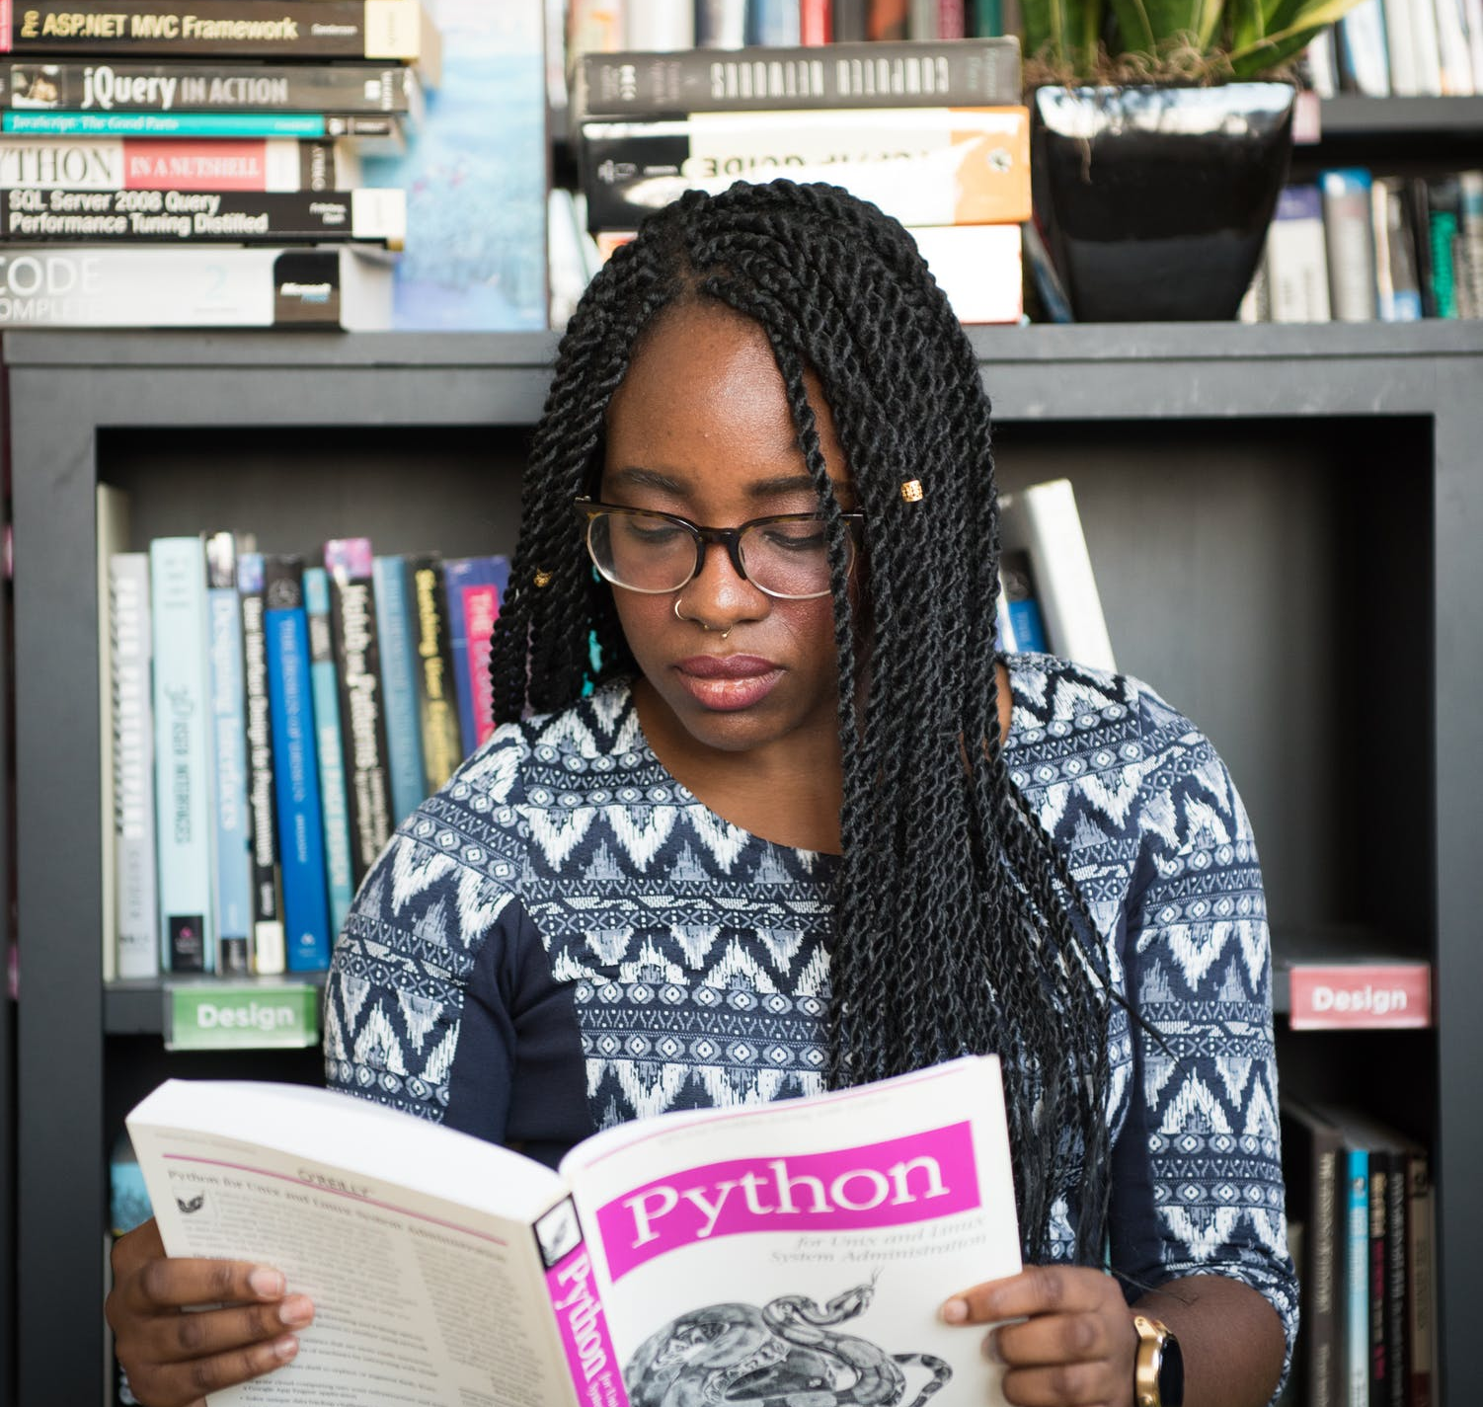
Happy reading!
Notes:
Thanks for listening and happy reading

Slide 16

Appendix

Slide 17
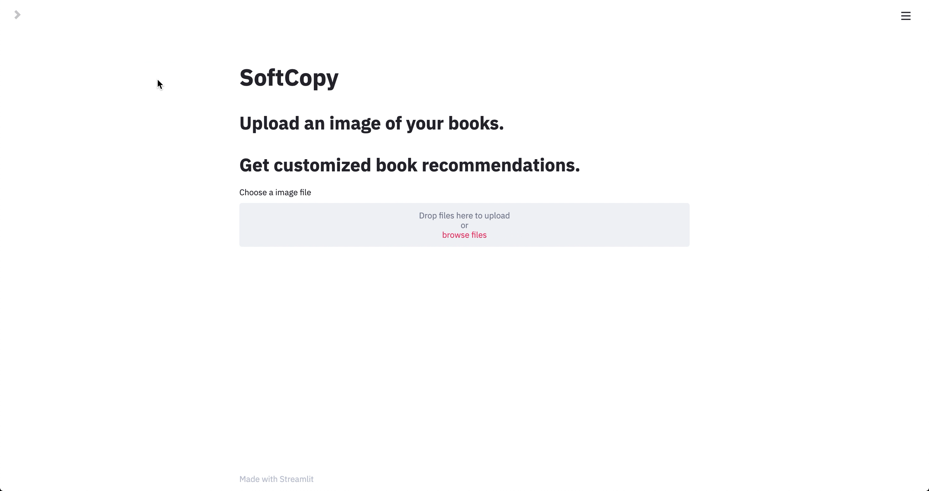
App Demo: About Section

Slide 18
Text Matching
5-step matching process:
Combine title and author strings
Tokenize into list of unigrams
Sort tokens alphabetically
Remove duplicate tokens
Compare with all books determine confidence level

Slide 19
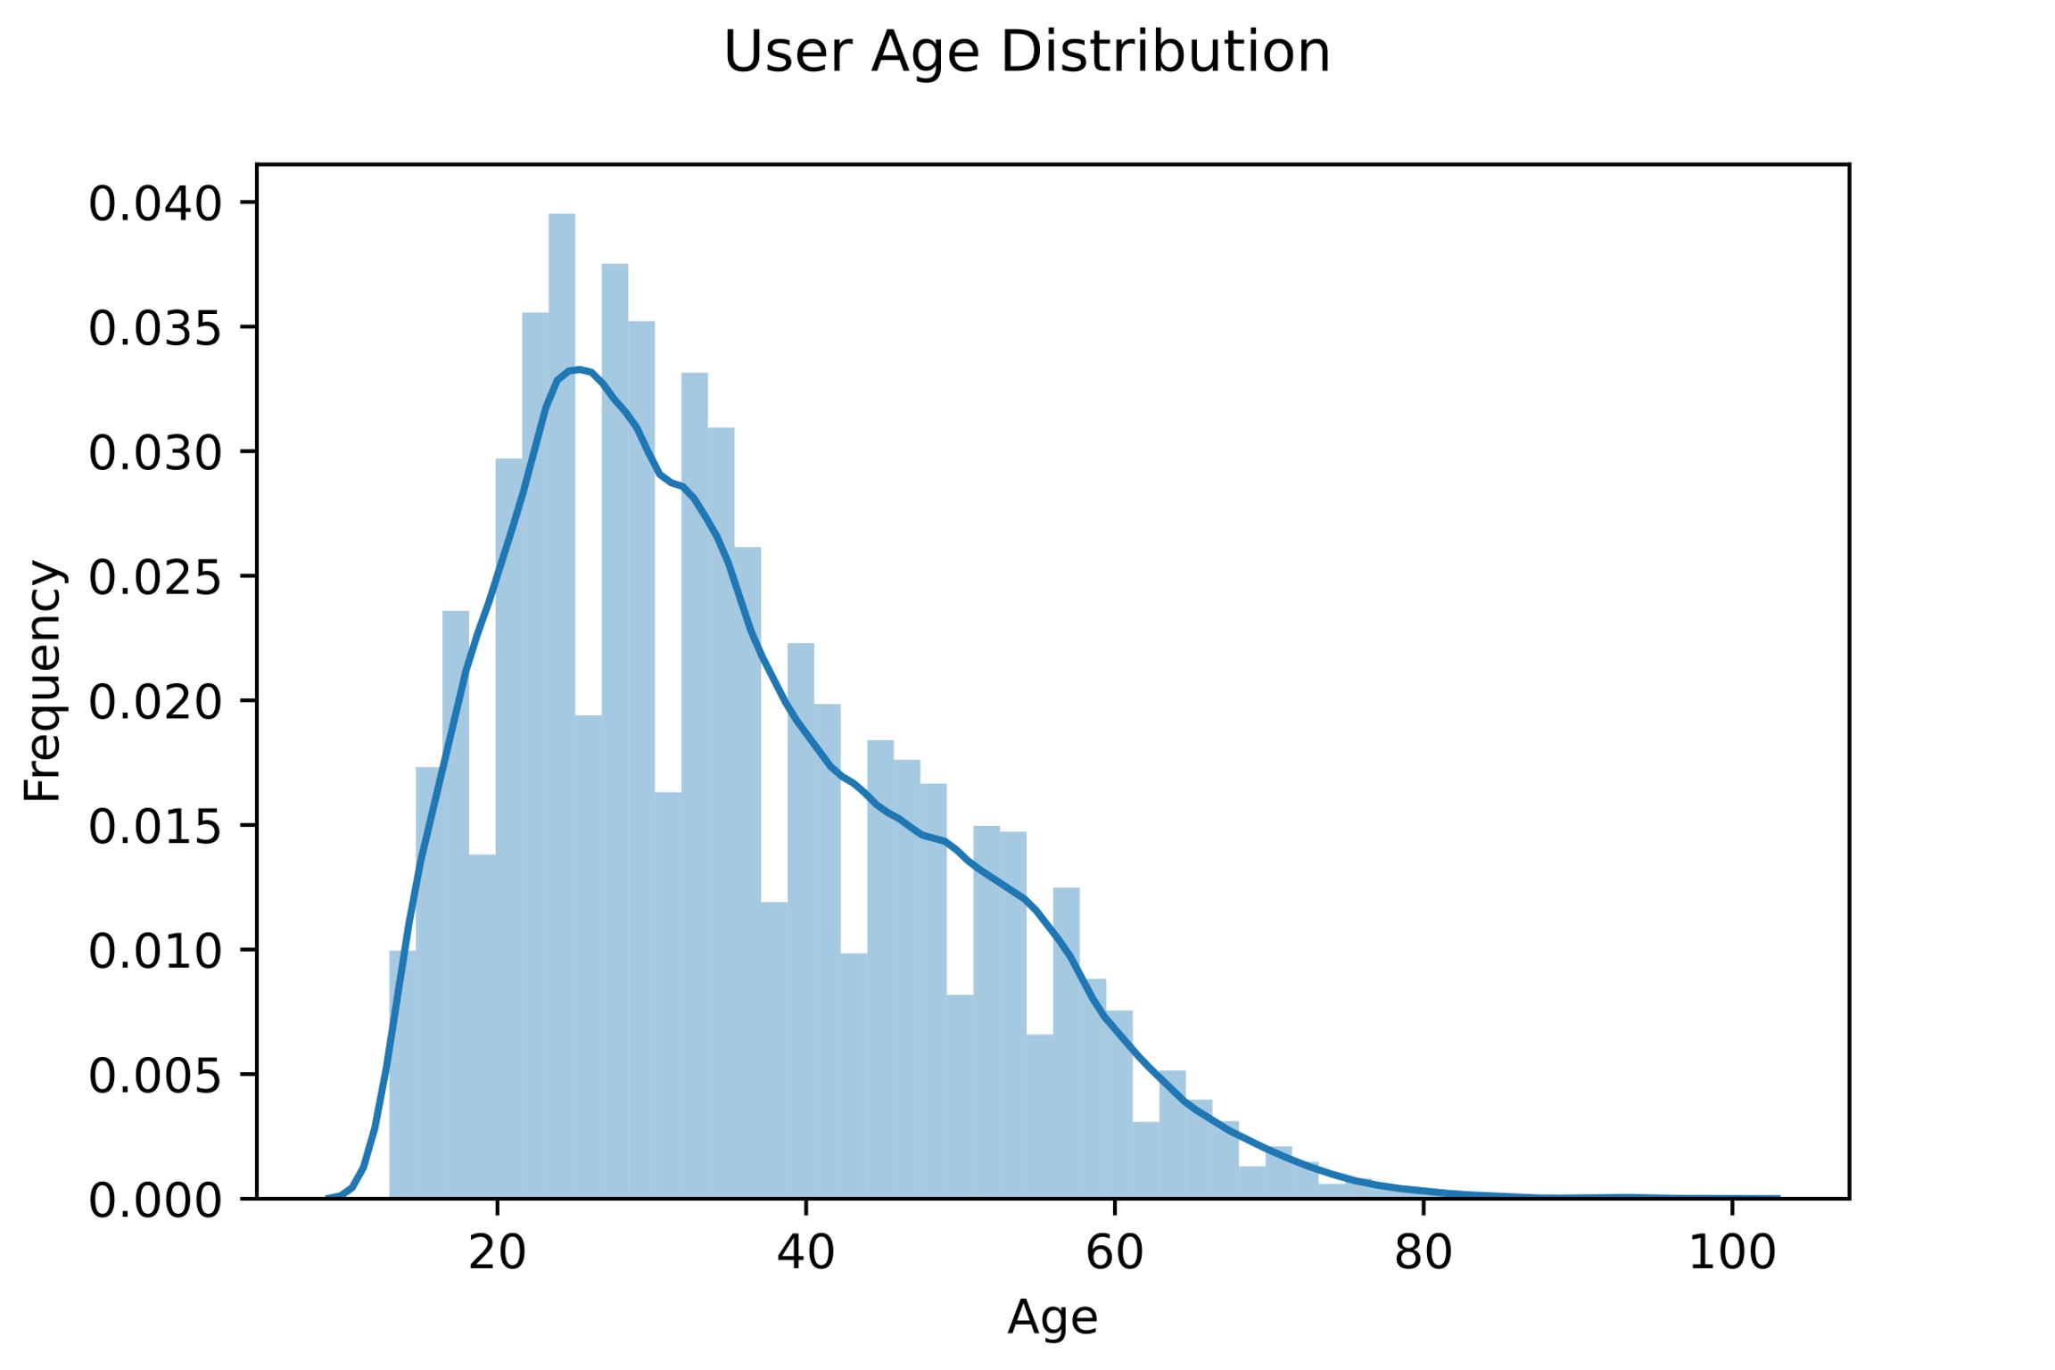
Recommendation Matrix Composition
134,299 ratings
10,077 books
12,854 unique reviewers

Slide 20
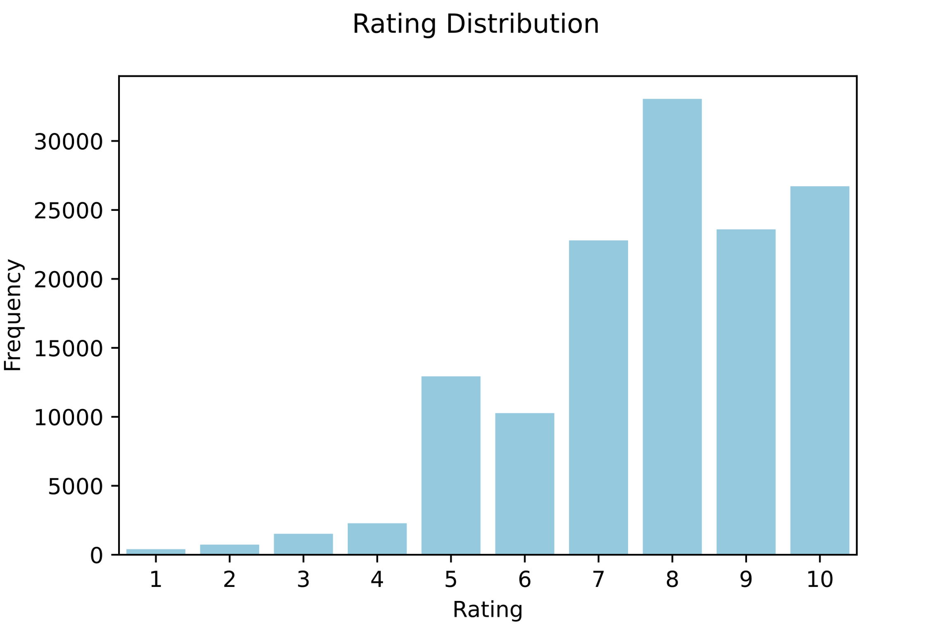
Recommendation Matrix Composition

Slide 21
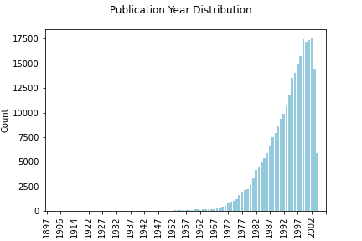
Recommendation Matrix Composition
Most books in matrix were published 1980-2000

